Slide 1
Label Aggregation: Matrix-Based Methods
Chien-Ju (CJ) Ho

Slide 2
Logistics – Assignment 3
Due: Mar 21 (Thursday)
Goal: Implement label aggregation algorithms
Majority voting
Another algorithm from the lectures (in either required or optional reading)
Dataset:
Recognizing Textual Entailment (RTE) task
800 tasks; 164 workers; 10 labels per task
Task: Whether the first sentence implies the second hypothesis

Slide 3
A Peek at the Data

Slide 4
Logistics – Project Milestone 1
Due: March 7 (No Late Submission)
What to include
Brief literature survey
1~2 paragraphs, at least 2~3 papers
Plan
See more in the requirement (not hard requirements. Think about what you want to do)
Include a timeline

Slide 5
Logistics - Presentations
High-level suggestions
When explaining math, give intuitions
Avoid putting too many words in the slides
Be enthusiastic and confident (if you are not, pretend to be)
An extreme (but helpful) example: Takahashi method

Slide 6
Label Aggregation
Goal:
Given a set of labels from a set of workers to tasks
Infer the true label of each task

Slide 7
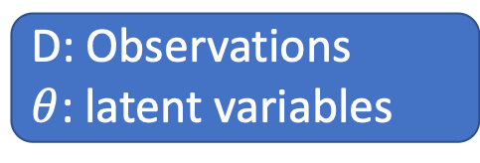
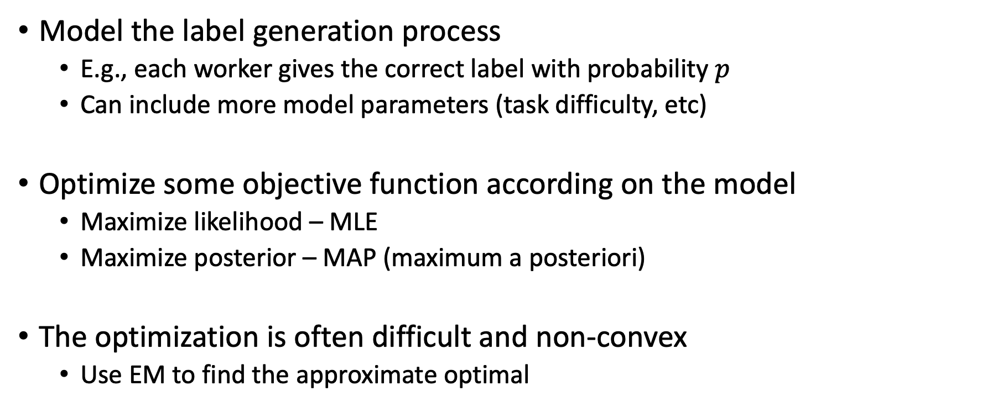

EM-Based Approach
Model the label generation process
E.g., each worker gives the correct label with probability $p$
Can include more model parameters (task difficulty, etc)
Optimize some objective function according on the model
Maximize likelihood – MLE
Maximize posterior – MAP (maximum a posteriori)
The optimization is often difficult and non-convex
Use EM to find the approximate optimal
D: Observations
$θ$: latent variables
Likelihood: $Pr⁡[D|θ]$
Posterior: $Pr⁡[θ|D]$

Slide 8
EM-Based Approach
Connection to supervised learning
Model of the labeling process: Hypothesis Set
Objective function (MLE, MAP): Error measure
EM: an algorithm to find a hypothesis within the set that minimizes the error
Reading question last lecture:
Is GLAD always better than majority voting?

Slide 9
EM-Based Approach : Pros and Cons
Pros
Empirically performs well
A generic framework
There is a HUGE amount of papers along this line, with different models of label generation
Cons
EM only attempts to find the local optimal of the objective function
Lack of theoretical guarantees on the final performance
Are we just getting lucky?

Slide 10
Today’s Lecture: Matrix-Based Approach

Slide 11
Matrix Representation of Workers’ Answers
 | Task 1 | Task 2 | Task 3 | Task 4 | …
Worker 1 | 1 | -1 | 1 | 1
Worker 2 | 1 | -1 | -1 | -1
Worker 3 | -1 | 1 | -1 | 1
Worker 4 | 1 | -1 | 1 | 1
…
?
?
?
?
Goal: Infer the true label of each task

Slide 12
Let’s Look at Another Problem First
Movie recommendation
 | Movie 1 | Movie 2 | Movie 3 | Movie 4 | Movie 5 | Movie 6
Alice | 5 | 4 |  | 1
Bob | 4 |  |  | 2 | 5
Charlie | 1 |  | 4 |  | 2
David |  | 3 | 2 |  |  | 4
…
Warmup Discussion:
Which movie will you recommend to Alice? Why?

Slide 13
Collaborative Filtering
 | Movie 1 | Movie 2 | Movie 3 | Movie 4 | Movie 5 | Movie 6
Alice | 5 | 4 |  | 1
Bob | 4 |  |  | 2 | 5
Charlie | 1 |  | 4 |  | 2
David |  | 3 | 2 |  |  | 4
…
Bob is probably most similar to Alice
User-based collaborative filtering
Examine users’ rating vector
Alice and Bob seem to have similar tastes
Bob likes Movie 5
Alice probably also likes Movie 5
We can calculate similarities among users, and weight their opinions accordingly

Slide 14
Collaborative Filtering
 | Movie 1 | Movie 2 | Movie 3 | Movie 4 | Movie 5 | Movie 6
Alice | 5 | 4 |  | 1
Bob | 4 |  |  | 2 | 5
Charlie | 1 |  | 4 |  | 2
David |  | 3 | 2 |  |  | 4
…
Item-based collaborative filtering
Examine items’ rating vectors
People who like/hate Movie 1 seem to like/hate Movie 5 as well
Since Alice likes Movie 1, she might also like Movie 5

Slide 15
Intuitions
Pros and Cons
Simple and interpretable
Cold-start and data sparsity problem (won’t discuss much in this lecture)
Key intuitions for collaborative filtering to work
A big number of ratings are controlled by a small number of parameters
You probably can see why this is related to crowdsourcing already
Low rank matrix approximation
A principled method to utilize the above intuition
 | Movie 1 | Movie 2 | Movie 3 | Movie 4 | Movie 5 | Movie 6
Alice | 5 | 4 |  | 1
Bob | 4 |  |  | 2 | 5
Charlie | 1 |  | 4 |  | 2
David |  | 3 | 2 |  |  | 4
…

Slide 16
A very short intro to Low rank matrix approximation

Slide 17
Rank of a Matrix
Matrix Rank
# linearly independent row (or column) vectors in a matrix
Example
What does low rank matrix imply?
Rank: 2
Rank: 2

Slide 18
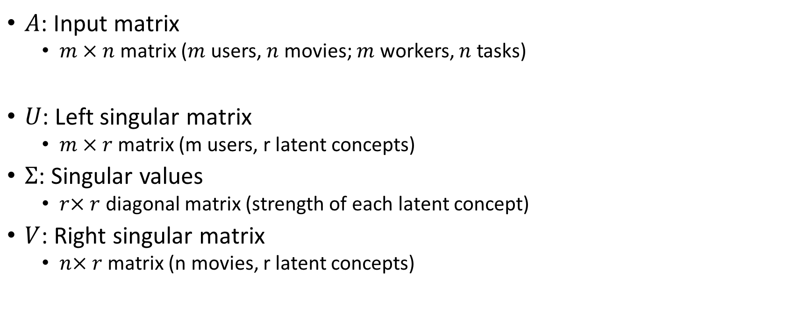
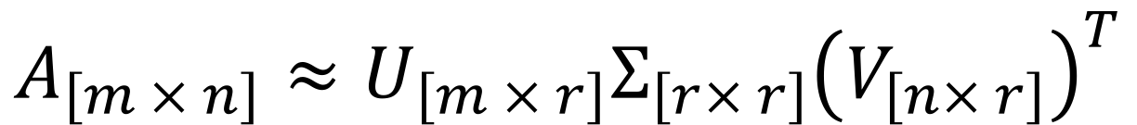
Singular Value Decomposition (SVD)
$$A_{\left[m × n\right]}≈U_{\left[m × r\right]}Σ_{\left[r× r\right]}{\left(V_{\left[n× r\right]}\right)}^{T}$$
$A$: Input matrix
$m × n$ matrix ($m$ users, $n$ movies; $m$ workers, $n$ tasks)
$U$: Left singular matrix
$m × r$ matrix (m users, r latent concepts)
$Σ$: Singular values
$r× r$ diagonal matrix (strength of each latent concept)
$V$: Right singular matrix
$n× r$ matrix (n movies, r latent concepts)
(Technically, the SVD definition here looks slightly different from standard definitions, but we can get this one with some discussion on matrix ranks.
(See the lecture notes by Tim Roughgarden for more details.)

Slide 19
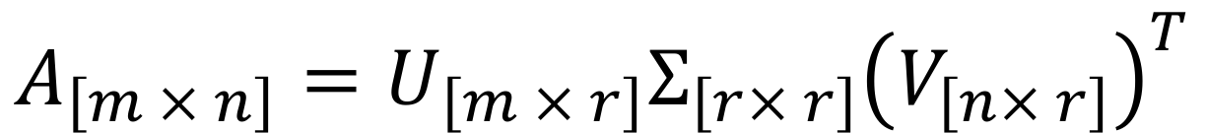
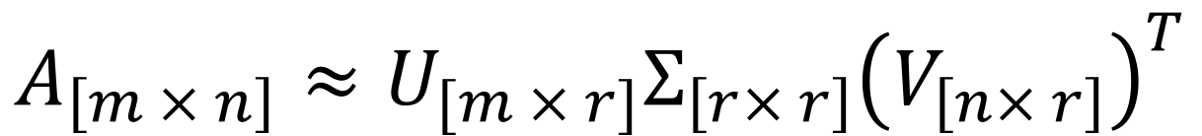
Singular Value Decomposition (SVD)
It is always possible to make such decomposition exactly equal (if we don’t put any restrictions on the rank r)
Low rank matrix decomposition
Can we approximate A with this decomposition with small rank r
$$A_{\left[m × n\right]}=U_{\left[m × r\right]}Σ_{\left[r× r\right]}{\left(V_{\left[n× r\right]}\right)}^{T}$$
$$A_{\left[m × n\right]}≈U_{[m × r]}Σ_{\left[r× r\right]}{\left(V_{\left[n× r\right]}\right)}^{T}$$
A dimension reduction technique; Reduce the number of parameters (and therefore requires less data to learn)

Slide 20
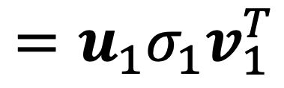
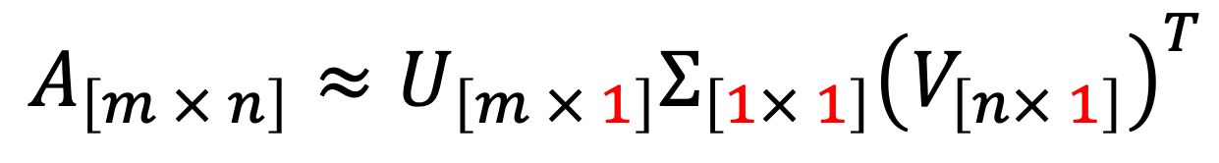
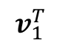
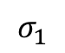
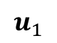
Rank 1 Approximation
$$A_{\left[m × n\right]}≈U_{\left[m × 1\right]}Σ_{\left[1× 1\right]}{\left(V_{\left[n× 1\right]}\right)}^{T}$$
$$=u_{1}σ_{1}v_{1}^{T}$$
n
$$u_{1}$$
$$σ_{1}$$
$$v_{1}^{T}$$
≈
A
Top right singular vector
m
Singular value
Top left singular vector

Slide 21
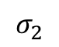

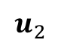
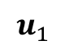
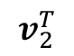
Rank k Approximation
$A_{\left[m × n\right]}≈U_{\left[m × k\right]}Σ_{\left[k× k\right]}{\left(V_{\left[n× k\right]}\right)}^{T}=\sum_{i}{u_{i}σ_{i}v_{i}^{T}}$
n
n
$$u_{1}$$
$$σ_{1}$$
$$v_{1}^{T}$$
$$u_{2}$$
$$σ_{2}$$
$$v_{2}^{T}$$
A
≈
Σ
V^{T}
=
m
m
+
U

Slide 22
Rank k Approximation
$A_{\left[m × n\right]}≈U_{\left[m × k\right]}Σ_{\left[k× k\right]}{\left(V_{\left[n× k\right]}\right)}^{T}=\sum_{i}{u_{i}σ_{i}v_{i}^{T}}$
n
n
$$u_{1}$$
$$σ_{1}$$
$$v_{1}^{T}$$
$$u_{2}$$
$$σ_{2}$$
$$v_{2}^{T}$$
A
≈
Σ
V^{T}
=
m
m
+
U

Slide 23
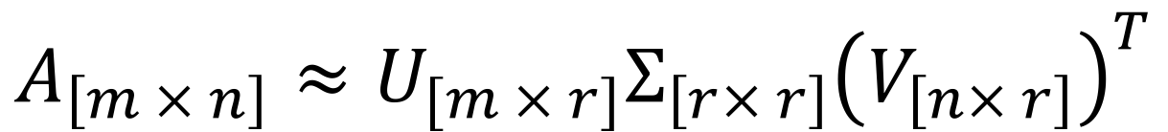
Movie Recommendation Example
Matrix
Alien
Serenity
Casablanca
Amelie
$$A_{\left[m × n\right]}≈U_{[m × r]}Σ_{\left[r× r\right]}{\left(V_{\left[n× r\right]}\right)}^{T}$$
1 1 1 0 0
3 3 3 0 0
4 4 4 0 0
5 5 5 0 0
0 2 0 4 4
0 0 0 5 5
0 1 0 2 2
0.13 0.02 -0.01
0.41 0.07 -0.03
0.55 0.09 -0.04
0.68 0.11 -0.05
0.15 -0.59 0.65
0.07 -0.73 -0.67
0.07 -0.29 0.32
12.4 0 0
0 9.5 0
0 0 1.3
=
x
x
0.56 0.59 0.56 0.09 0.09
0.12 -0.02 0.12 -0.69 -0.69
0.40 -0.80 0.40 0.09 0.09

Slide 24
Movie Recommendation Example
$$A_{\left[m × n\right]}≈U_{[m × r]}Σ_{\left[r× r\right]}{\left(V_{\left[n× r\right]}\right)}^{T}$$
Matrix
Alien
Serenity
Casablanca
Amelie
SciFi-concept
Romance-concept
“strength” of the SciFi-concept
1 1 1 0 0
3 3 3 0 0
4 4 4 0 0
5 5 5 0 0
0 2 0 4 4
0 0 0 5 5
0 1 0 2 2
0.13 0.02 -0.01
0.41 0.07 -0.03
0.55 0.09 -0.04
0.68 0.11 -0.05
0.15 -0.59 0.65
0.07 -0.73 -0.67
0.07 -0.29 0.32
12.4 0 0
0 9.5 0
0 0 1.3
=
x
x
0.56 0.59 0.56 0.09 0.09
0.12 -0.02 0.12 -0.69 -0.69
0.40 -0.80 0.40 0.09 0.09
SciFi-concept
Romance-concept

Slide 25
Netflix Challenge
$1 million award for people beating their algorithm by 10%
Simply implementing SVD already beats the algorithm Netflix was using…
The winning team uses an ensemble of many methods
SVD is one major component

Slide 26
How to Perform SVD
Should be covered in linear algebra class….
Most likely, you will just call an existing library

Slide 27
Let’s (finally) get back to label aggregation
Who moderates the moderators? Crowdsourcing abuse detection in user-generated content. Ghosh, Kale, and McAfee. EC 2011.

Slide 28

User Generated Content
Common practice to use user ratings to determine whether a content is good or not
When a content receives a bad rating
is the content bad, or
is the rating bad?
Given users ratings, how to decide content quality.
This is a crowdsourcing label aggregation problem. With each rating being a label provided by a wor.ker

Slide 29

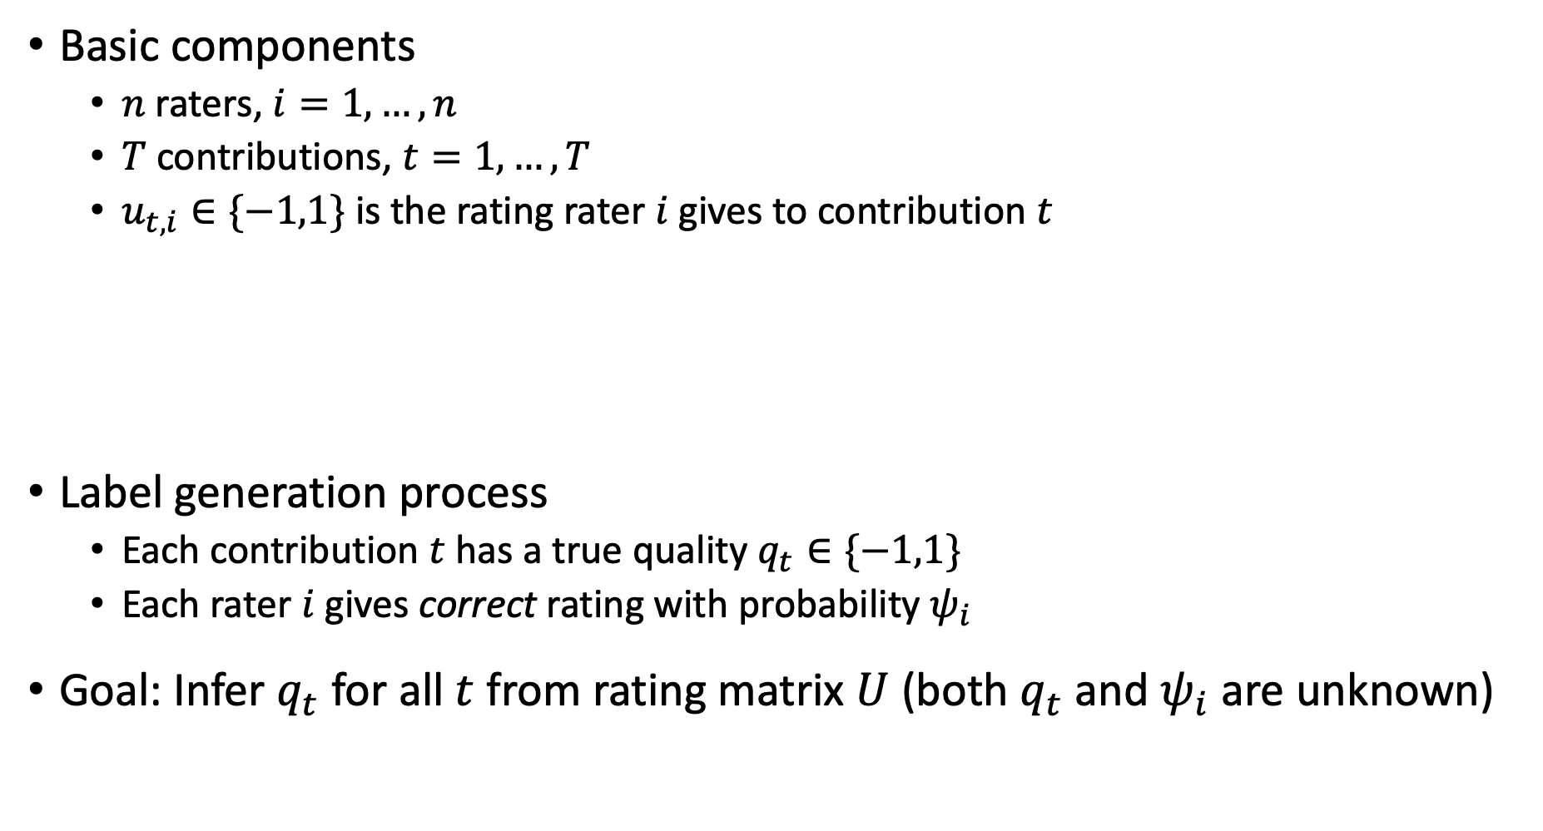
Model
Basic components
$n$ raters, $i=1,…,n$
$T$ contributions, $t=1,…,T$
$u_{t,i}∈\{−1,1\}$ is the rating rater $i$ gives to contribution $t$
Label generation process
Each contribution $t$has a true quality $q_{t}∈\{−1,1\}$
Each rater $i$ gives correct rating with probability $ψ_{i}$
Goal: Infer $q_{t}$ for all $t$ from rating matrix $U$ (both $q_{t}$ and $ψ_{i}$ are unknown)
 | Rater 1 | Rater 2 | Rater 3 | Rater 4 | …
Contribution 1 | 1 | -1 | -1 | 1
Contribution 2 | -1 | 1 | 1 | -1
Contribution 3 | 1 | 1 | -1 | 1
…
$$U$$

Slide 30
The Goal Seems Different from Movie Recommendation
In movie recommendation
Goal: Fill in the empty ratings (and recommend the movie with highest one)
In this paper
Assumption: all ratings are given
Goal: Infer the latent variable (true quality)
Connection: Low rank approximation of the rating matrix
 | Rater 1 | Rater 2 | Rater 3 | Rater 4 | …
Contribution 1 | 1 | -1 | -1 | 1
Contribution 2 | -1 | 1 | 1 | -1
Contribution 3 | 1 | 1 | -1 | 1
…

Slide 31
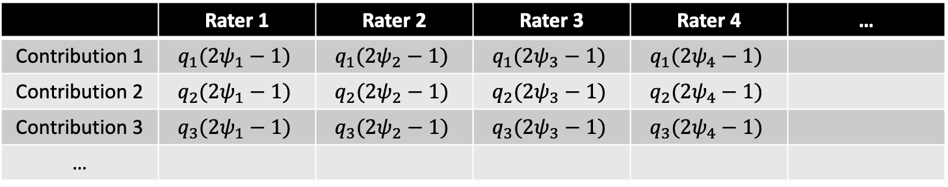
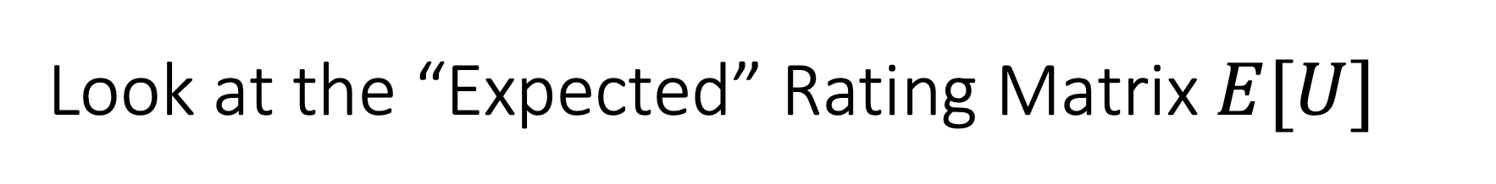
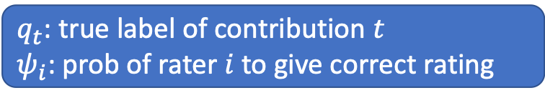
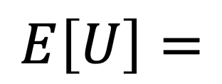
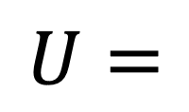
Look at the “Expected” Rating Matrix$E[U]$
 | Rater 1 | Rater 2 | Rater 3 | Rater 4 | …
Contribution 1 | 1 | -1 | -1 | 1
Contribution 2 | -1 | 1 | 1 | -1
Contribution 3 | 1 | 1 | -1 | 1
…
$$U=$$
 | Rater 1 | Rater 2 | Rater 3 | Rater 4 | …
Contribution 1 | $$q_{1}(2ψ_{1}−1)$$ | $$q_{1}(2ψ_{2}−1)$$ | $$q_{1}(2ψ_{3}−1)$$ | $$q_{1}(2ψ_{4}−1)$$
Contribution 2 | $$q_{2}(2ψ_{1}−1)$$ | $$q_{2}(2ψ_{2}−1)$$ | $$q_{2}(2ψ_{3}−1)$$ | $$q_{2}(2ψ_{4}−1)$$
Contribution 3 | $$q_{3}(2ψ_{1}−1)$$ | $$q_{3}(2ψ_{2}−1)$$ | $$q_{3}(2ψ_{3}−1)$$ | $$q_{3}(2ψ_{4}−1)$$
…
$$E\left[U\right]=$$
$q_{t}$: true label of contribution $t$
$ψ_{i}$: prob of rater $i$to give correct rating

Slide 32
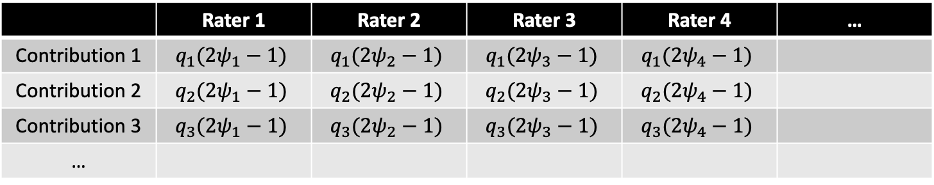
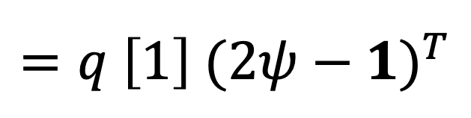
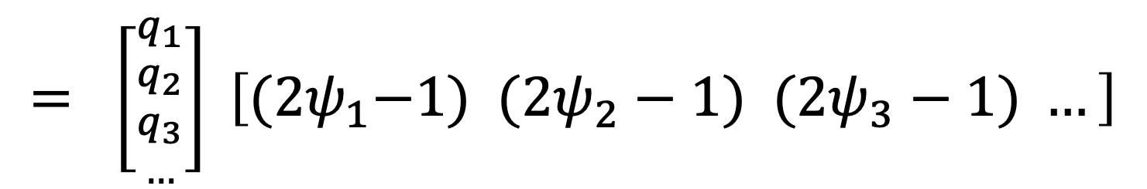
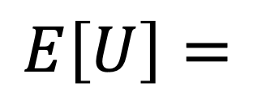
Look at the “Expected” Rating Matrix$E[U]$
 | Rater 1 | Rater 2 | Rater 3 | Rater 4 | …
Contribution 1 | $$q_{1}(2ψ_{1}−1)$$ | $$q_{1}(2ψ_{2}−1)$$ | $$q_{1}(2ψ_{3}−1)$$ | $$q_{1}(2ψ_{4}−1)$$
Contribution 2 | $$q_{2}(2ψ_{1}−1)$$ | $$q_{2}(2ψ_{2}−1)$$ | $$q_{2}(2ψ_{3}−1)$$ | $$q_{2}(2ψ_{4}−1)$$
Contribution 3 | $$q_{3}(2ψ_{1}−1)$$ | $$q_{3}(2ψ_{2}−1)$$ | $$q_{3}(2ψ_{3}−1)$$ | $$q_{3}(2ψ_{4}−1)$$
…
$$E\left[U\right]=$$
$$= \left[{{q_{1} \atop q_{2}} \atop {q_{3} \atop …}}\right] \left[{(2ψ}_{1}−1) (2ψ_{2}−1) (2ψ_{3}−1) …\right]$$
$$=q \left[1\right]{ (2ψ−1)}^{T}$$
This is the exact singular value decomposition with rank 1

Slide 33
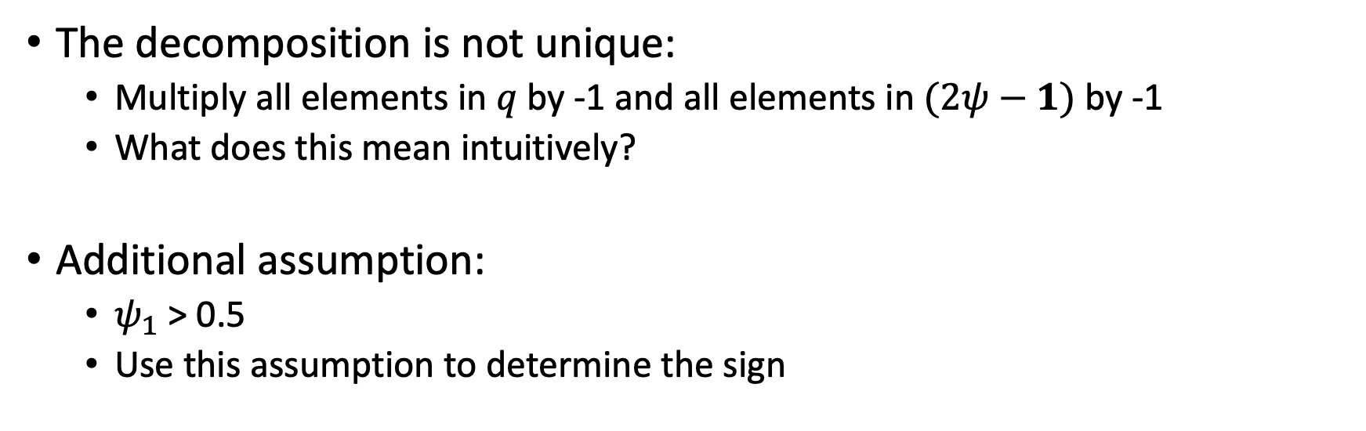
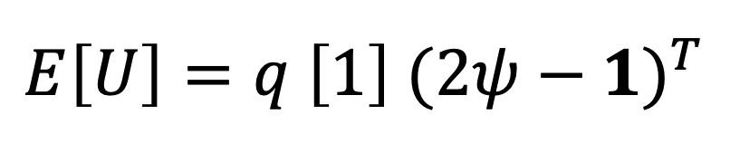
Look at the “Expected” Rating Matrix$E[U]$
$$E\left[U\right]=q \left[1\right]{ (2ψ−1)}^{T}$$
The decomposition is not unique:
Multiply all elements in $q$ by -1 and all elements in $(2ψ−1)$ by -1
What does this mean intuitively?
Additional assumption:
$ψ_{1}$ > 0.5
Use this assumption to determine the sign

Slide 34
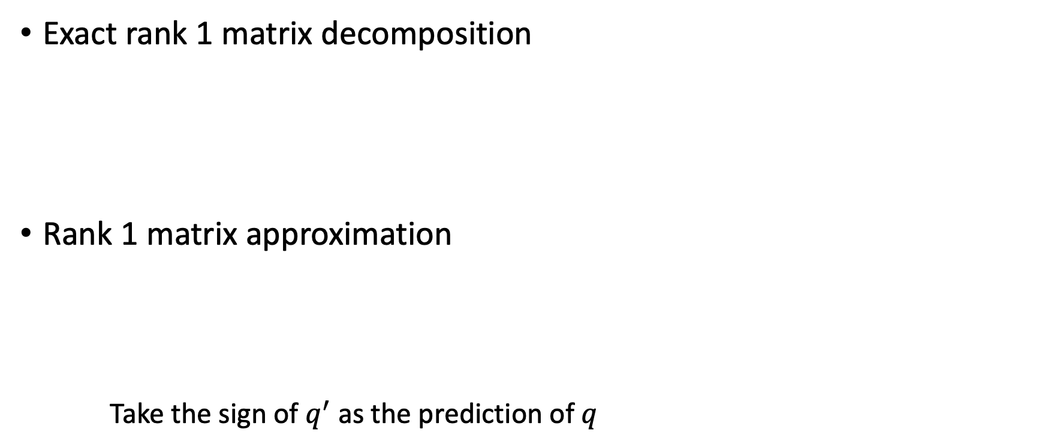

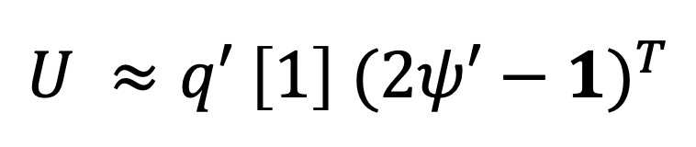
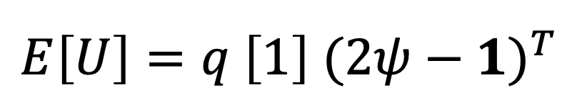
From $E[U]$ to $U$
Exact rank 1 matrix decomposition
Rank 1 matrix approximation
Take the sign of $q^{′}$ as the prediction of $q$
$$E\left[U\right]=q \left[1\right]{ (2ψ−1)}^{T}$$
$$U ≈q′ \left[1\right]{ (2ψ′−1)}^{T}$$

Slide 35
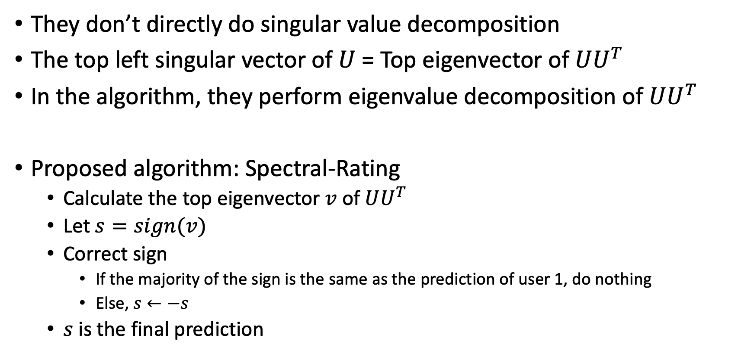
More Details
They don’t directly do singular value decomposition
The top left singular vector of $U$= Top eigenvector of $UU^{T}$
In the algorithm, they perform eigenvalue decomposition of $UU^{T}$
Proposed algorithm: Spectral-Rating
Calculate the top eigenvector $v$ of $UU^{T}$
Let $s=sign(v)$
Correct sign
If the majority of the sign is the same as the prediction of user 1, do nothing
Else, $s←−s$
$s$ is the final prediction

Slide 36
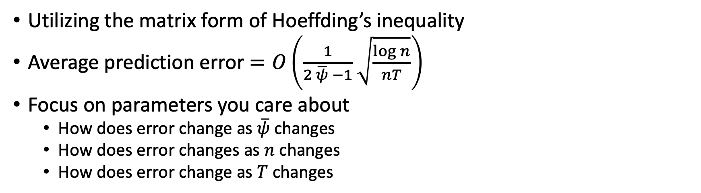
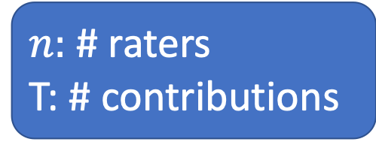
Theoretical Guarantee
$n:$ # raters
T: # contributions
Utilizing the matrix form of Hoeffding’s inequality
Average prediction error $=O\left(\frac{1}{2 \overline{ψ} −1}\sqrt{\frac{\log{n}}{nT}}\right)$
Focus on parameters you care about
How does error change as $\overline{ψ}$ changes
How does error changes as $n$ changes
How does error change as $T$ changes
How to interpret a bound like this?

Slide 37
Extensions
Not every rater rates every contribution
 | Rater 1 | Rater 2 | Rater 3 | Rater 4 | …
Contribution 1 | 1 |  | -1 | 1
Contribution 2 | -1 | 1
Contribution 3 |  |  | -1 | 1
…

Slide 38
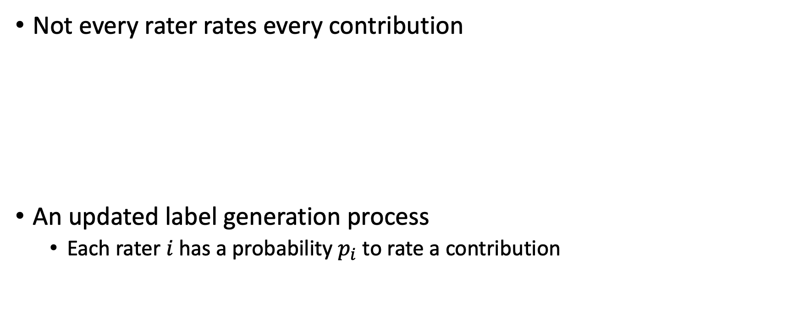
Extensions
Not every rater rates every contribution
An updated label generation process
Each rater $i$has a probability $p_{i}$ to rate a contribution
 | Rater 1 | Rater 2 | Rater 3 | Rater 4 | …
Contribution 1 | 1 | 0 | -1 | 1
Contribution 2 | -1 | 1 | 0 | 0
Contribution 3 | 0 | 0 | -1 | 1
…
Is this a reasonable model?
Why do you think we need this model?

Slide 39
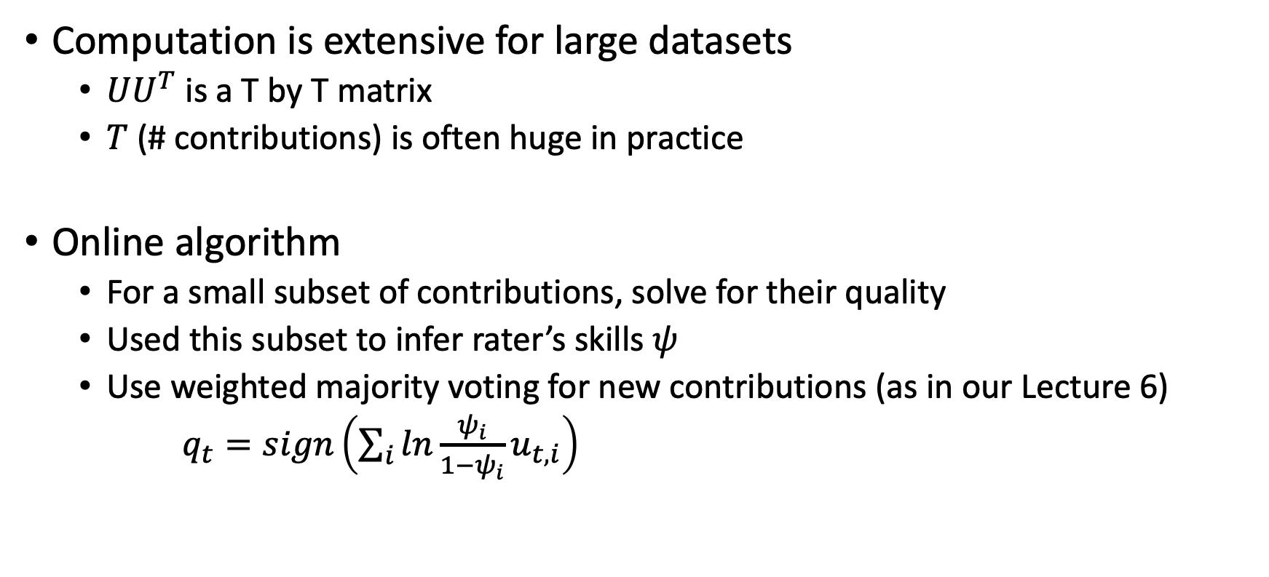
Extensions
Computation is extensive for large datasets
$UU^{T}$ is a T by T matrix
$T$ (# contributions) is often huge in practice
Online algorithm
For a small subset of contributions, solve for their quality
Used this subset to infer rater’s skills $ψ$
Use weighted majority voting for new contributions (as in our Lecture 6)
$q_{t}=sign\left(\sum_{i}{ln\frac{ψ_{i}}{1−ψ_{i}}u_{t,i}}\right)$

Slide 40
Extensions
Algorithm robustness against rater manipulations
Changing their “skills” to influence the algorithm outcome
Changing their labeling strategy (no randomized) to influence the algorithm outcome
Collude with other raters to influence the outcome for a particular contribution
The results are “robust” if the ratio of manipulations is not large
A recent research direction
Learning with the presence of strategic behavior

Slide 41
Learning with the Presence of Strategic Behavior

Slide 42
Example: Spam Classification

Slide 43
Example: Spam Classification

Slide 44
Example: Spam Classification

Slide 45
Discussion
What do you like/dislike about this work?
If you are required to do a project as a follow-up for this work, what would you do?

Slide 46
What We Learned So Far
EM-based methods
Empirically performs well
Relatively computationally efficient
No theoretical guarantee
Matrix-based methods
Comes with theoretical guarantee
Computationally expensive
Can we achieve the best of both worlds?

Slide 47
Spectral Methods Meet EM
Spectral Methods Meet EM: A Provably Optimal Algorithm for Crowdsourcing. Zhang et al. JMLR 2016.
The main issue for EM: Might converge to local optimum

Slide 48
Spectral Methods Meet EM
Key idea:
Estimate the “confusion matrix” from data
Using the estimation as the initial point for running the EM algorithm
Key results
Given this fine-tuned starting point, with high probability, EM can achieve global optimal

Slide 49
Open Discussion
What kind of research do you like? Why?
Empirically oriented: Design new algorithms and examine them on some datasets. No theoretical guarantees.
Theoretically oriented: Make assumptions on the target problems. Design algorithms and prove theoretical properties of the algorithms.

